Slide 1

Machine Learning Project July 11, 2020 Team Mohammed Ahmed Kaiser Haag Gredel Lynch Evans Onyare Maria Rotich

Slide 2
Overview
In this presentation we will illustrate Machine Learning using a Supervised Learning, Linear Regression algorithm to predict the number of weekly Covid-19 deaths
Hypothesis:
Is it possible to accurately predict the number of weekly Covid-19 deaths by zip code?

Slide 3
Data

Slide 4
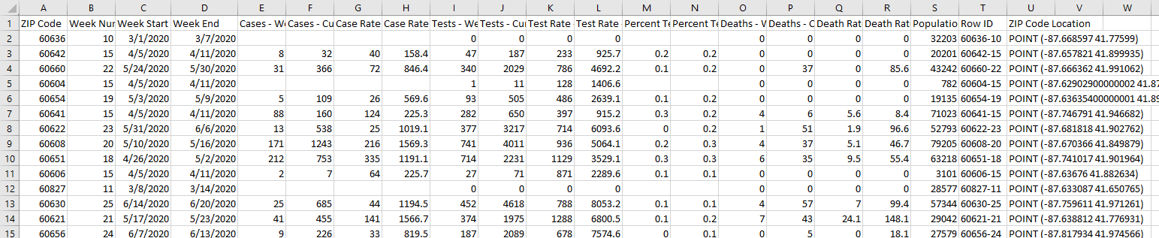
Original Dataset COVID-19 Cases, Tests, and Deaths by ZIP Code HealthData.gov Format: CSV file Weeks analyzed: March 8, 2020 thru June 20,2020 URL: https://healthdata.gov/dataset/covid-19-cases-tests-and-deaths-zip-code

Slide 5
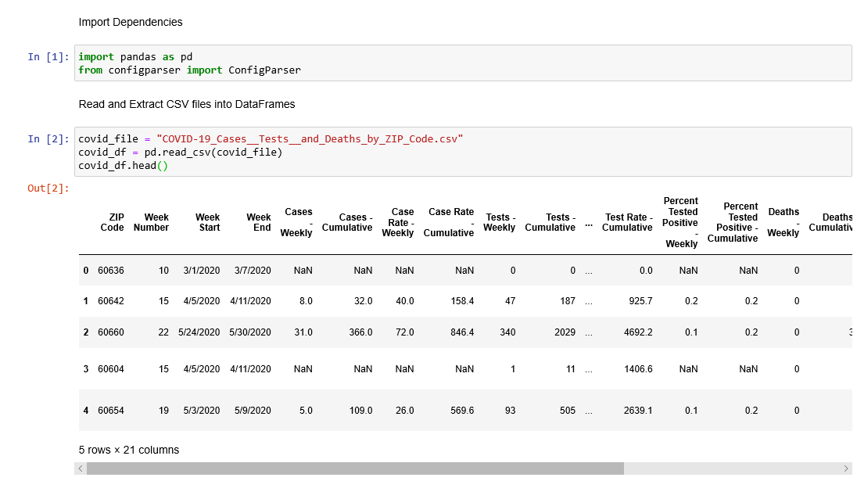
Data Cleaning Process
Using Python, Pandas, and Jupyter Notebook
Read the CSV File

Slide 6
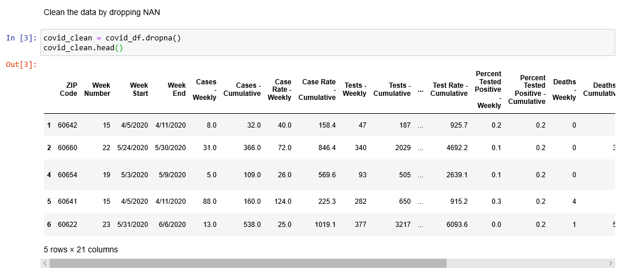
Data Cleaning Process
Dropped Na fields

Slide 7
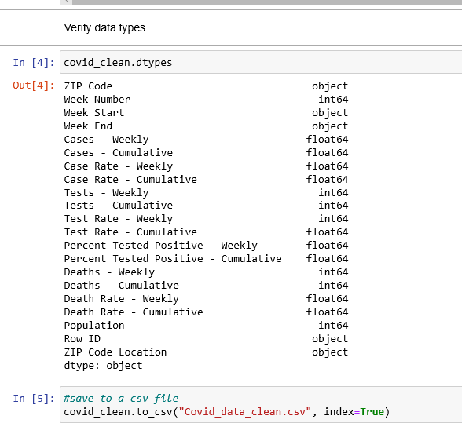
Data Cleaning Process
Verified the data types of the input values
Saved the clean data frame as a new CSV file

Slide 8
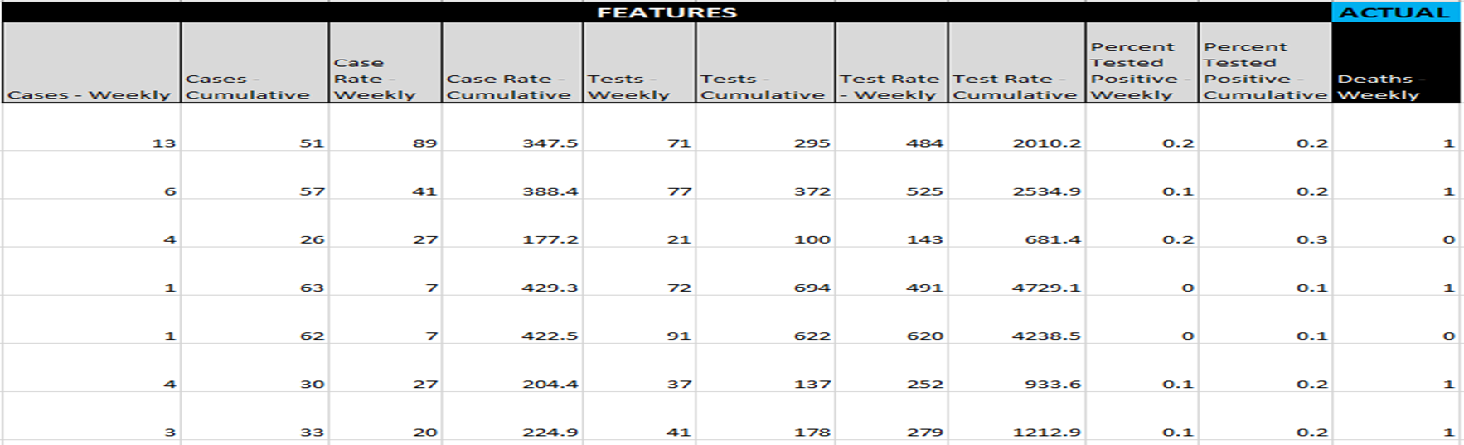
The Clean Data

Slide 9
Machine Learning

Slide 10
Machine Learning
Libraries: SkLearn, Numpy, Matplotlib, Pandas
Language: Python
Tools: Jupyter Notebook

Slide 11
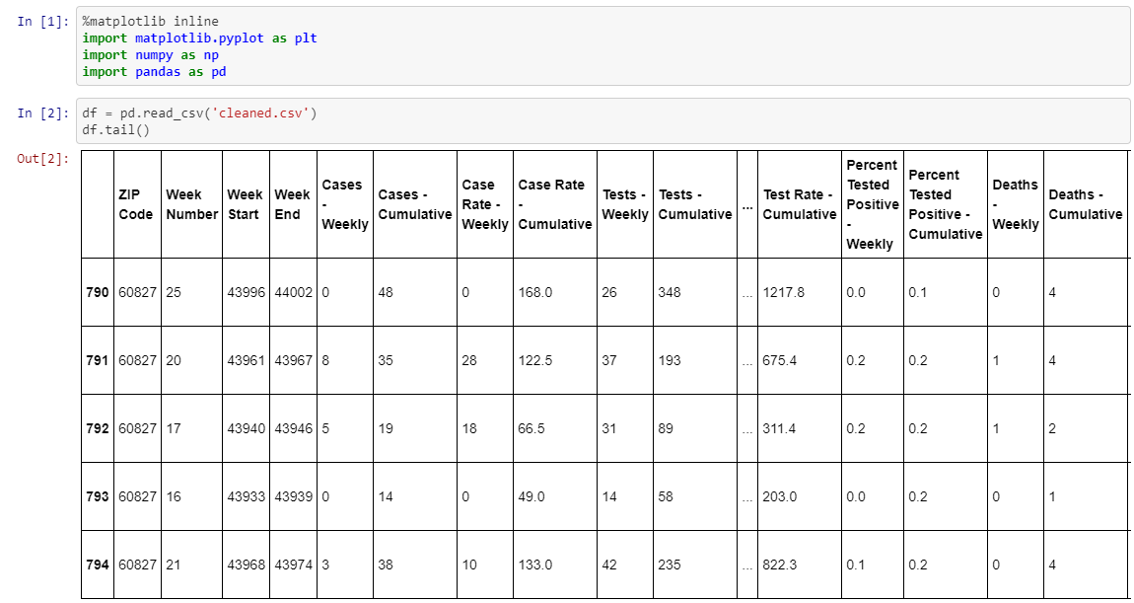
Machine Learning Import Dependencies Read CSV file and convert into a DataFrame

Slide 12
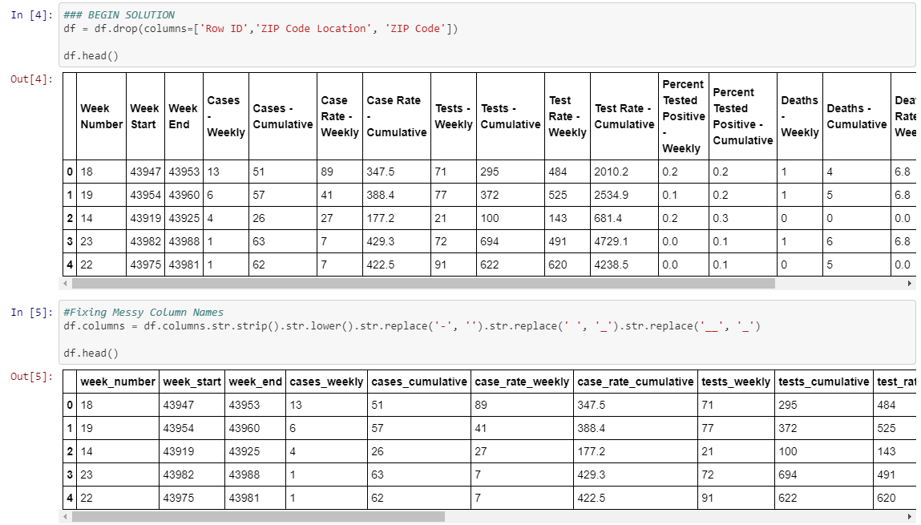
Machine Learning Drop irrelevant columns Alter column names

Slide 13
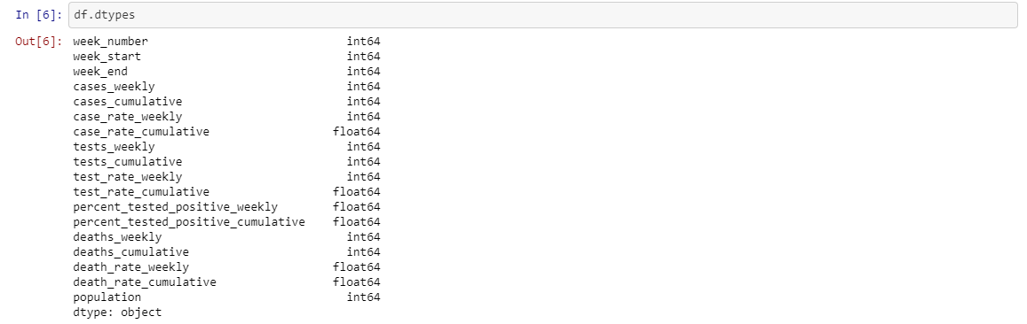
Machine Learning Verify the data types

Slide 14
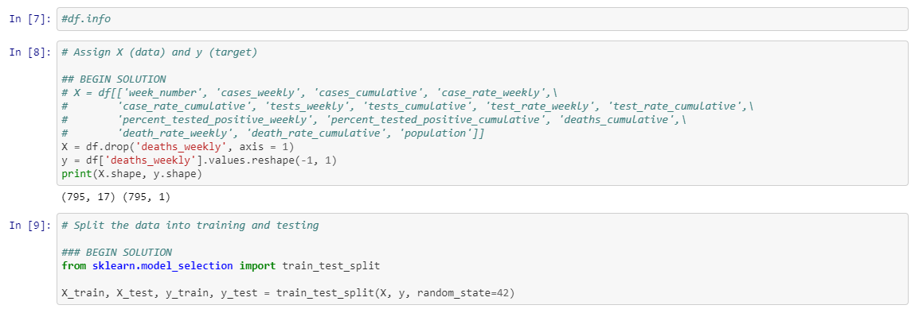
Machine Learning Define X data Define y data Reshape data Use sklearn to split data into train and test data

Slide 15
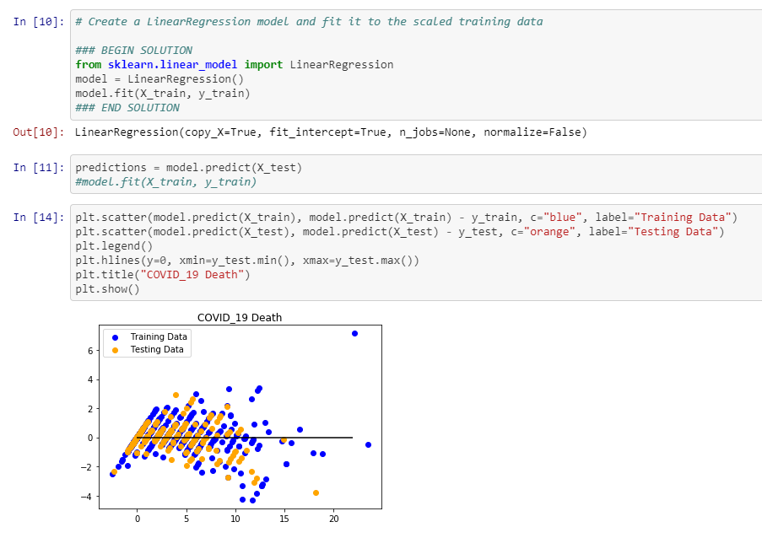
Machine Learning Linear Regression Import sklearn Linear Regression Create and train the model on the test data Plot test and training data

Slide 16
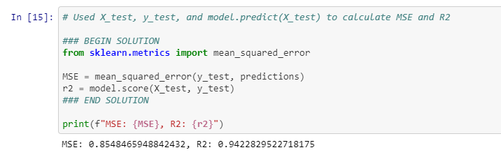
Prediction Scores
R2 Score : Based on the R2 score, our model is 94% accurate in predicting the number of weekly Covid-19 deaths
Mean Squared Error (MSE) : 0.85

Slide 17
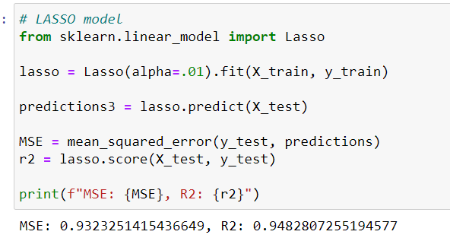
Machine Learning Lasso Regression URL: https://www.statisticshowto.com/lasso-regression
Lasso regression is a type of linear regression that uses shrinkage.
Shrinkage is where data values are shrunk towards a central point, like the mean.
The lasso procedure encourages simple, sparse models (i.e. models with fewer parameters).”

Slide 18
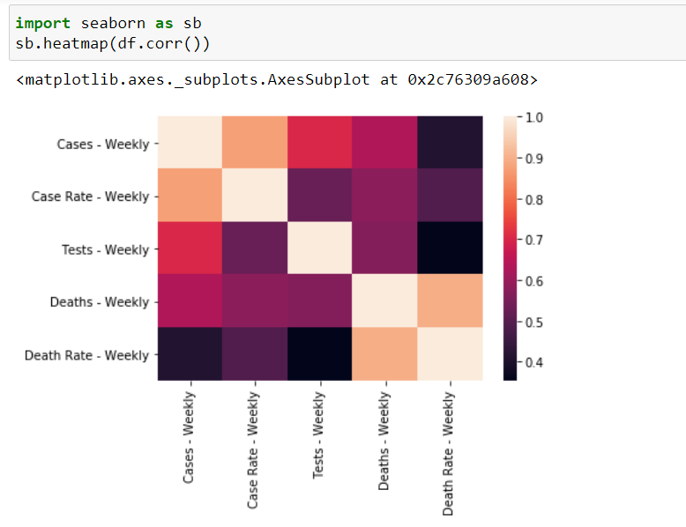
Machine Learning Seaborn URL: https://www.youtube.com/watch?v=NUXdtN1W1FE

Slide 19
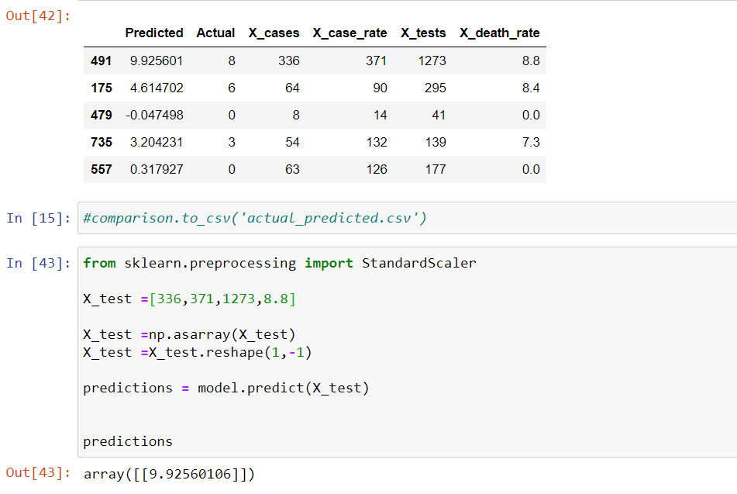
Machine Learning Testing using values outside of our X_test dataset

Slide 20
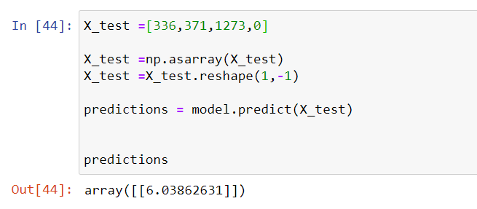
Machine Learning Testing using values outside of our X_test dataset

Slide 21
The reshaping of the data resulted in an array of an arrays, which prevented pandas from creating the new comparison Dataframe Resolution: Converted the array of an array into a list
Challenges

Slide 22
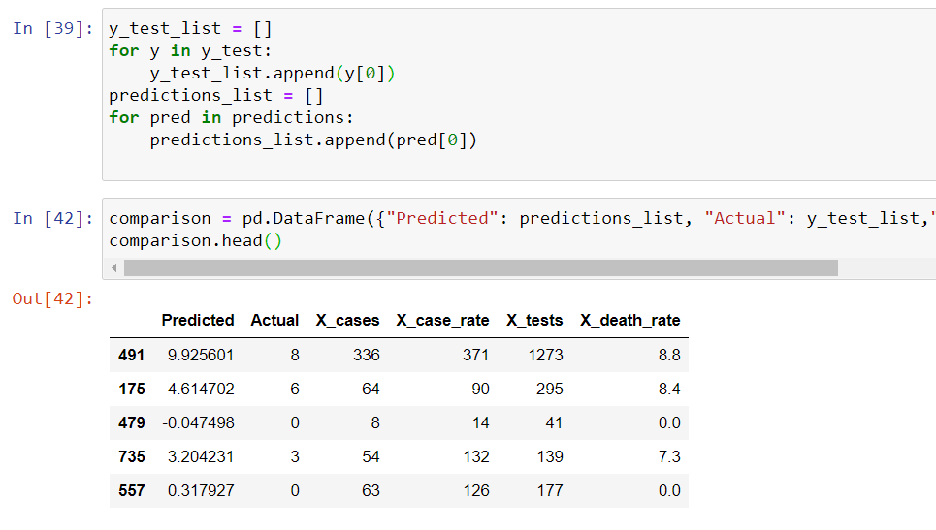
Created loop to create a list
Created a DataFrame that captured the predicted and actual death values
Created a CSV for actual vs predicted results for Tableau

Slide 23
Visualizations

Slide 24
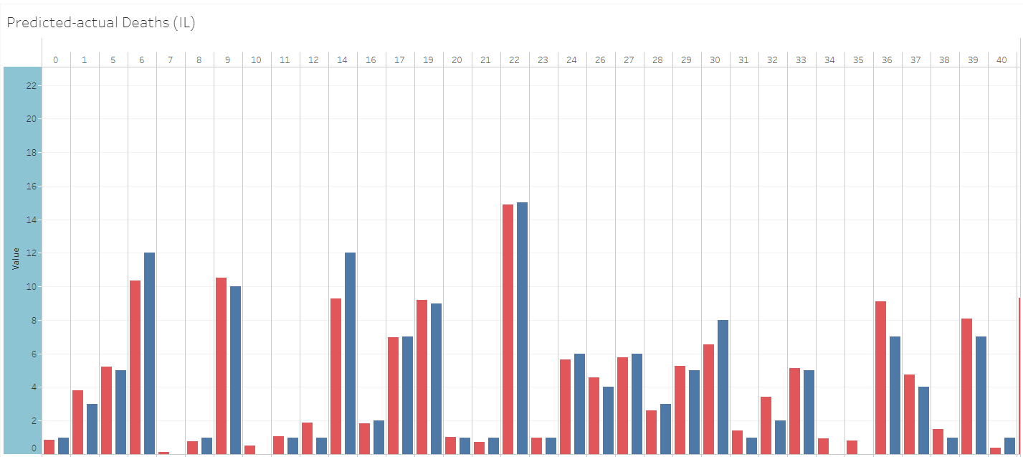
Tableau Showing: This bar chart captures actual vs. predicted weekly deaths Actual : Blue Predicted: Red URL: https://public.tableau.com/profile/maria.chebichii#!/vizhome/Predicted-actualDeathsIL/Predicted-actualDeathsIL

Slide 25
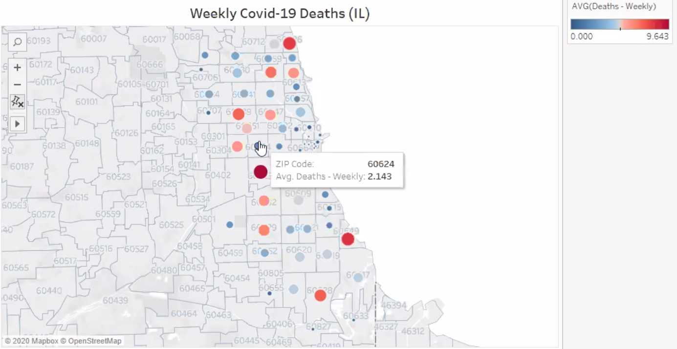
Tableau Showing: This map was produced from the cleaned dataset to capture which areas experienced more weekly deaths URL: https://public.tableau.com/profile/maria.chebichii#!/vizhome/Covid_19WeeklydeathsIL/weeklydeaths

Slide 26

Questions??
This Photo by Unknown Author is licensed under CC BY-NC

